Slide 1
Software Project Management
1

Slide 2
Project Management Concepts
The Management Spectrum
The People
The Product
The Process
The Project

Slide 3
What is Project Management?
Project Management is a series of different processes designed to assist managers in accomplishing definite goals by carefully organizing, controlling, and executing the project. The main challenge of software project management is to achieve project goals while keeping in mind the project scope, time, quality, and cost.

Slide 4
What is a Project?
A project is a temporary endeavor undertaken to create a unique product, service or result. A project is defined as temporary because it has a defined beginning and end time, and it is unique because it has a particular set of operations designed to accomplish a goal

Slide 5
The primary characteristics of a project are:
It has a definite start and end point
Once the end point is reached, the project is over
It is attempting to achieve something new
Project must meet the customer or stakeholder requirements

Slide 6
What is Project Management?
Project Management is a discipline to plan, organize, motivate, and control the resources to achieve specific project goals. The main objective of project management is to achieve project goals and targets while keeping in mind the project scope, time, quality, and cost. It facilitates the project workflow with team collaboration on a single project.

Slide 7
What is Project Management?
Project management actually began in the early 1950s. The need for project management arose after observing the benefits of organizing work within the project and the critical need to coordinate across different departments and professionals.

Slide 8
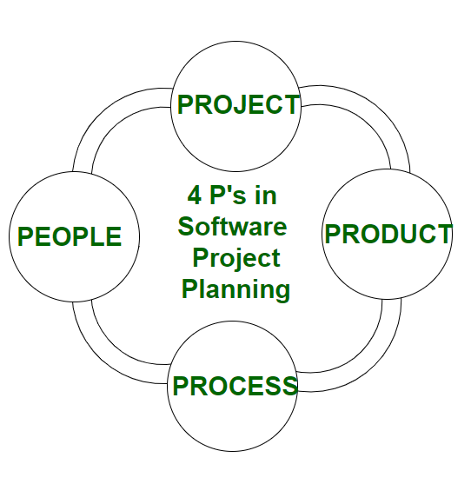
The Management Spectrum
4 P’s in Software Project Planning
There are 4 critical components in software project planning which are known as the 4P’s namely:
Product
Process
People
Project

Slide 9
The Management Spectrum
Effective software project management focuses on these items (in this order)
  The people
    Deals with the cultivation of motivated, highly skilled people
    Consists of the stakeholders, the team leaders, and the software team
  The product
    Product objectives and scope should be established before a project can be planned
  The process
    The software process provides the framework from which a comprehensive plan for software development can be established
  The project
    Planning and controlling a software project is done for one primary reason…it is the only known way to manage complexity
    In a 1998 survey, 26% of software projects failed outright, 46% experienced cost and schedule overruns

Slide 10
People
The most important component of a product and its successful implementation is human resources. In building a proper product, a well-managed team with clear-cut roles defined for each person/team will lead to the success of the product. We need to have a good team in order to save our time, cost, and effort. Some assigned roles in software project planning are project manager, team leaders, stakeholders, analysts, and other IT professionals. Managing people successfully is a tricky process which a good project manager can do.

Slide 11
Product
As the name inferred, this is the deliverable or the result of the project. The project manager should clearly define the product scope to ensure a successful result, control the team members, as well technical hurdles that he or she may encounter during the building of a product. The product can consist of both tangible or intangible such as shifting the company to a new place or getting a new software in a company.

Slide 12
Process
In every planning, a clearly defined process is the key to the success of any product. It regulates how the team will go about its development in the respective time period. The Process has several steps involved like, documentation phase, implementation phase, deployment phase, and interaction phase.

Slide 13
Project
The last and final P in software project planning is Project. In this phase, the project manager plays a critical role. They are responsible to guide the team members to achieve the project’s target and objectives, helping & assisting them with issues, checking on cost and budget, and making sure that the project stays on track with the given deadlines.

Slide 14
People
Product
Process
Project

Slide 15
The People: The Stakeholders
Five categories of stakeholders
  Senior managers – define business issues that often have significant influence on the project
  Project (technical) managers – plan, motivate, organize, and control the practitioners who do the work
  Practitioners – deliver the technical skills that are necessary to engineer a product or application
  Customers – specify the requirements for the software to be engineered and other stakeholders who have a peripheral interest in the outcome
  End users – interact with the software once it is released for production use

Slide 16
The People: Team Leaders
Competent practitioners often fail to make good team leaders; they just don’t have the right people skills
Qualities to look for in a team leader
  Motivation – the ability to encourage technical people to produce to their best ability
  Organization – the ability to mold existing processes (or invent new ones) that will enable the initial concept to be translated into a final product
  Ideas or innovation – the ability to encourage people to create and feel creative even when they must work within bounds established for a particular software product or application
Team leaders should use a problem-solving management style
  Concentrate on understanding the problem to be solved
  Manage the flow of ideas
  Let everyone on the team know, by words and actions, that quality counts and that it will not be compromised
(More on next slide)

Slide 17
The People: Team Leaders (continued)
Another set of useful leadership traits
  Problem solving – diagnose, structure a solution, apply lessons learned, remain flexible
  Managerial identity – take charge of the project, have confidence to assume control, have assurance to allow good people to do their jobs
  Achievement – reward initiative, demonstrate that controlled risk taking will not be punished
  Influence and team building – be able to “read” people, understand verbal and nonverbal signals, be able to react to signals, remain under control in high-stress situations

Slide 18
The People: The Software Team
Seven project factors to consider when structuring a software development team
  The difficulty of the problem to be solved
  The size of the resultant program(s) in source lines of code
  The time that the team will stay together
  The degree to which the problem can be modularized
  The required quality and reliability of the system to be built
  The rigidity of the delivery date
  The degree of sociability (communication) required for the project
(More on next slide)

Slide 19
The People: The Software Team (continued)
Four organizational paradigms for software development teams
  Closed paradigm – traditional hierarchy of authority; works well when producing software similar to past efforts; members are less likely to be innovative
  Random paradigm – depends on individual initiative of team members; works well for projects requiring innovation or technological breakthrough; members may struggle when orderly performance is required
  Open paradigm – hybrid of the closed and random paradigm; works well for solving complex problems; requires collaboration, communication, and consensus among members
  Synchronous paradigm – organizes team members based on the natural pieces of the problem; members have little communication outside of their subgroups
(More on next slide)

Slide 20
The People: The Software Team (continued)
Five factors that cause team toxity (i.e., a toxic team environment)
  A frenzied work atmosphere
  High frustration that causes friction among team members
  A fragmented or poorly coordinated software process
  An unclear definition of roles on the software team
  Continuous and repeated exposure to failure
How to avoid these problems
  Give the team access to all information required to do the job
  Do not modify major goals and objectives, once they are defined, unless absolutely necessary
  Give the team as much responsibility for decision making as possible
  Let the team recommend its own process model
  Let the team establish its own mechanisms for accountability (i.e., reviews)
  Establish team-based techniques for feedback and problem solving

Slide 21
People
Product
Process
Project

Slide 22
The Product
The scope of the software development must be established and bounded
  Context – How does the software to be built fit into a larger system, product, or business context, and what constraints are imposed as a result of the context?
  Information objectives – What customer-visible data objects are produced as output from the software? What data objects are required for input?
  Function and performance – What functions does the software perform to transform input data into output? Are there any special performance characteristics to be addressed?
Software project scope must be unambiguous and understandable at both the managerial and technical levels
(More on next slide)

Slide 23
The Product (continued)
Problem decomposition
  Also referred to as partitioning or problem elaboration
  Sits at the core of software requirements analysis
Two major areas of problem decomposition
  The functionality that must be delivered
  The process that will be used to deliver it

Slide 24
People
Product
Process
Project

Slide 25
The Process
Getting Started
  The project manager must decide which process model is most appropriate based on
    The customers who have requested the product and the people who will do the work
    The characteristics of the product itself
    The project environment in which the software team works
  Once a process model is selected, a preliminary project plan is established based on the process framework activities
  Process decomposition then begins
  The result is a complete plan reflecting the work tasks required to populate the framework activities
Project planning begins as a melding of the product and the process based on the various framework activities

Slide 26
People
Product
Process
Project

Slide 27
The Project: A Common Sense Approach
Start on the right foot
  Understand the problem; set realistic objectives and expectations; form a good team
Maintain momentum
  Provide incentives to reduce turnover of people; emphasize quality in every task; have senior management stay out of the team’s way
Track progress
  Track the completion of work products; collect software process and project measures; assess progress against expected averages
Make smart decisions
  Keep it simple; use COTS or existing software before writing new code; follow standard approaches; identify and avoid risks; always allocate more time than you think you need to do complex or risky tasks
Conduct a post mortem analysis
  Track lessons learned for each project; compare planned and actual schedules; collect and analyze software project metrics; get feedback from teams members and customers; record findings in written form

Slide 28
The Project: The W⁵HH Principle
A series of questions that lead to a definition of key project characteristics
and the resultant project plan
Why is the system being developed?
  Assesses the validity of business reasons and justifications
What will be done?
  Establishes the task set required for the project
When will it be done?
  Establishes a project schedule
Who is responsible for a function?
  Defines the role and responsibility of each team member
Where are they organizationally located?
  Notes the organizational location of team members, customers, and other stakeholders
How will the job be done technically and managerially?
  Establishes the management and technical strategy for the project
How much of each resource is needed?
  Establishes estimates based on the answers to the previous questions

Slide 30
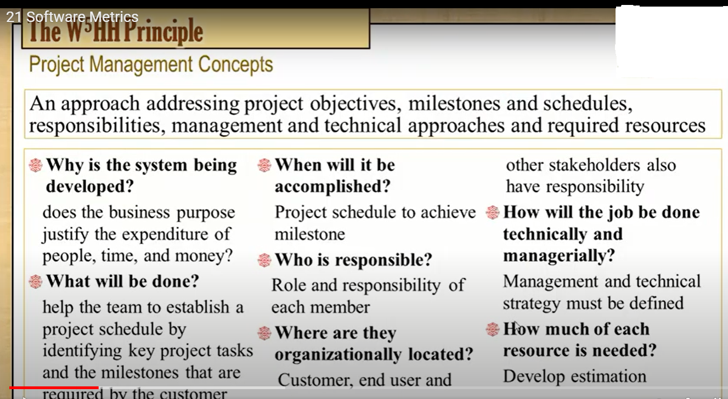

Slide 31
Summary
People
Project
Product
Process
☺

